Slide 1

Serverless Computing
Simon Stride

Slide 2
Serverless <> serverless
In serverless we still need a server to run on – it just might not be the service you’re used to!
Doesn’t HAVE to be in the cloud – could be on prem – but most started with AWS Lambda functions in 2014
Examples:
AWS Lambda
Azure Functions
Google Cloud Functions
Fn
Notes:
First things first…
Fn = container based serverless platform, run anywhere

Slide 3



What does that actually mean?
Host (Hardware) Server
VM (Guest) Server
Application Service
API Endpoint
API Endpoint
API Endpoint
Notes:
Conceptually, strip away the components of your application piece by piece. Think about a Web API.
If you run a service on premises, in 2019, chances are you care about everything in grey.
If you move to a serverless compute model in the cloud, you stop caring about everything except for the logic behind each end point

Slide 4
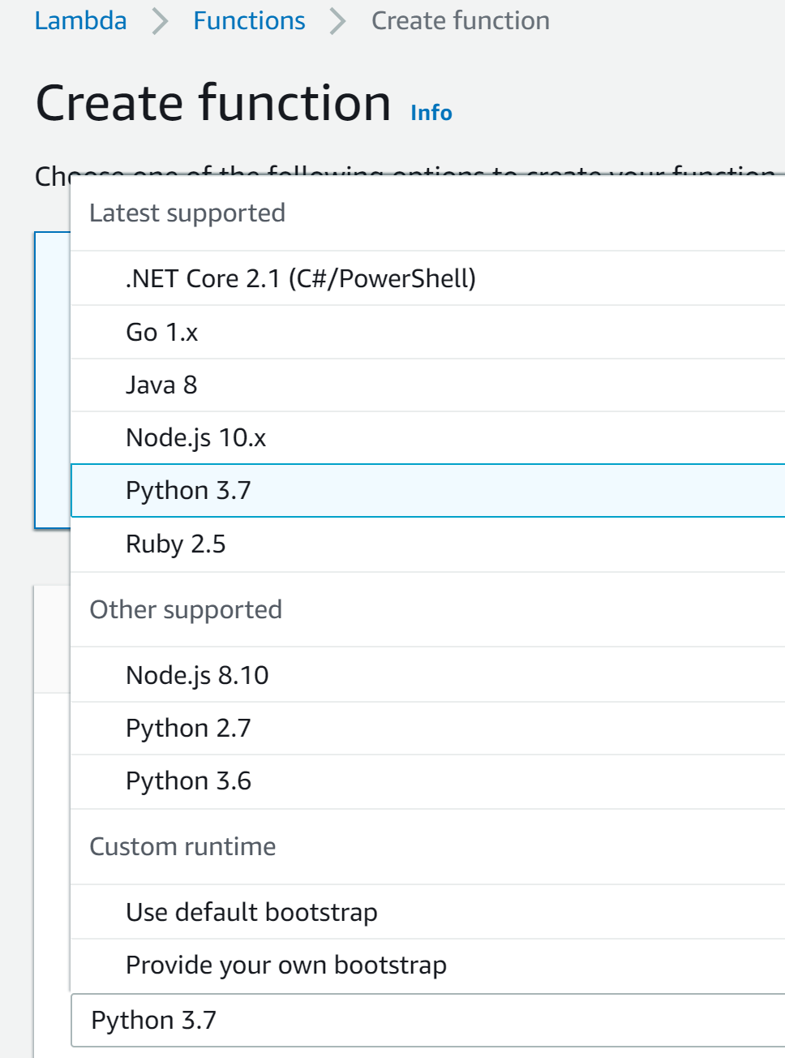
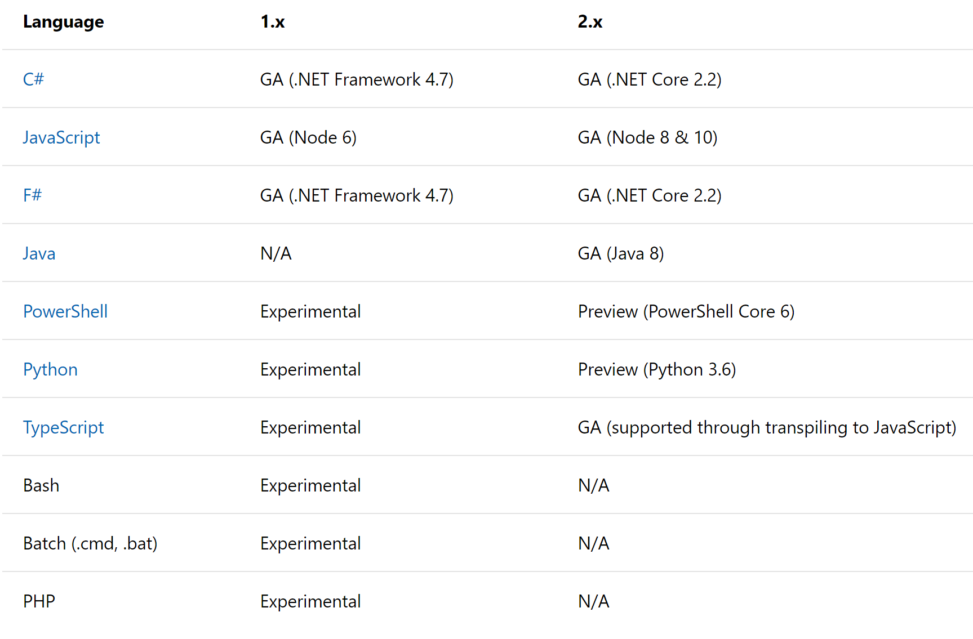
Pick the right language for the job!
Notes:
e.g. pick python 3.7 or python 3.6

Slide 5
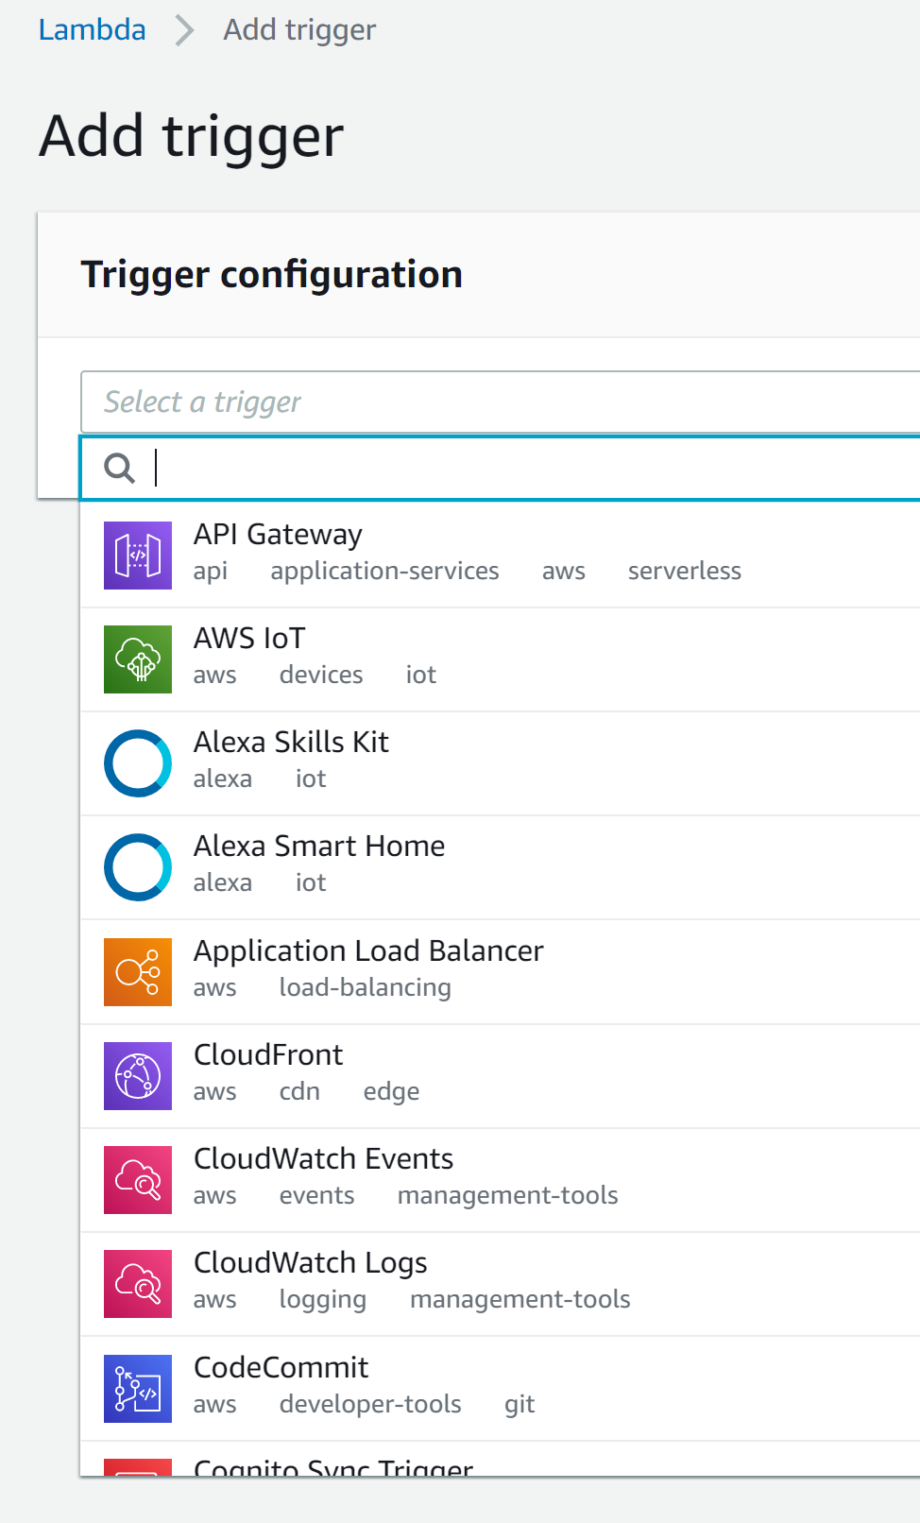
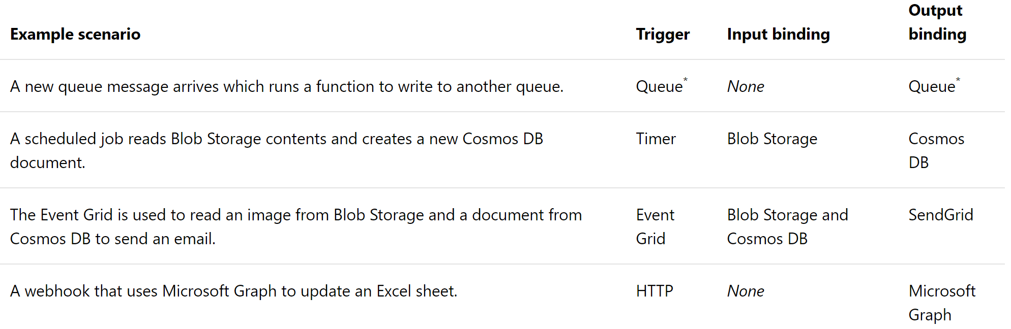
Just run the code

Slide 6
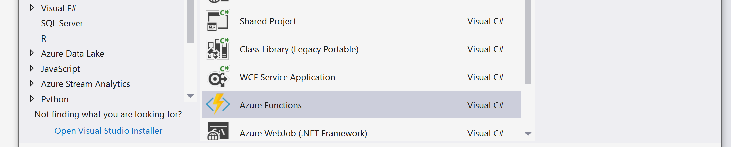
Azure Functions Projects in VS

Slide 7

Advantages
Cost effective – pay for what you use, at fractions of a cent for low-end plans
Many cloud function services include a significant free tier
No need to patch the underlying OS
Granular scalability – you can add more power to each function separately
Pick the right language for each action – your solution could be a hotchpotch of Java, C#.net, JavaScript, Python, Powershell!
Notes:
Cost of pay-per-function means crystal-clear breakdown of which parts of your application cost what
n.b. Serverless aims to be stateless however orchestrator or complex operations could use “durable” or long-running equivalents

Slide 8
Disadvantages
“Hydration Time” – initial delay in execution
Use a separate, external service for:
Managing user-endpoints e.g. Azure Gateway
Managing multi-step processes e.g. Durable functions
Managing security e.g. AWS IAM
Complexity of assembly moved from application to infrastructure

Slide 9
Serverless vs containers
Use serverless when
You need granular scaling and/or billing
Vendor lock-in doesn’t cause concern
Each serverless action is stateless and short running
Dependencies between functions are minimal
Use containers when
Vendor lock-in is a concerned
Short-term (server side) state management matters
You need to bundle data (e.g. trained models) with the image
Your code has complex dependencies between functions
You code needs to interact with the OS/filesystem

Slide 10


Questions?

